Slide 1
Equipment Inventory
Updated 1/2023

Slide 2
Topics
General Equipment Guidelines
Capital Equipment
Minor Equipment
Annual Inventory Verification
Property Disposition

Slide 3
General Equipment Guidelines
Equipment Inventory
UK Property Business Procedures (BPM E-12)
Equipment Inventory Policy: http://www.uky.edu/ufs/sites/www.uky.edu.ufs/files/bpm/E-12-3.pdf
EBO Training: http://cafebusinesscenter.ca.uky.edu/equipment

Slide 4
General Equipment Guidelines
Equipment Inventory Requirements
Office must:
Maintain control of all items of furniture, equipment, vehicles and other moveable property assigned to the area, regardless of cost.
Use the proper general ledger account when purchasing equipment.
Control and record the location of property.
Report transfers of property between units.
Complete the annual physical inventory of property in the possession of, or under the supervision of, the office by the assigned deadline.

Slide 5
General Equipment Guidelines
Equipment Inventory Requirements
Office must:
Verify the accuracy of the inventory records for equipment during the annual inventory process and throughout the year.
Report surplus or obsolete property.
Report lost, stolen, and destroyed equipment items to Area Extension Director (AED). AED will communicate with the EBO.
Maintain reasonable precautions in protecting all property (capital and non-capital) regardless of value.

Slide 6
General Equipment Guidelines
Equipment Inventory Requirements
Office must:
Ensure any equipment kept offsite for an extended period of time is documented.
Ensure that county owned equipment is not utilized for personal use or financial gain.
Adhere to university inventory deadlines as appropriate for state owned property or federal excess property.

Slide 7
General Equipment Guidelines
County offices should maintain the following lists of inventory. Each tracked separately and annually verified by fiscal contact.
County owned capital equipment
County owned minor equipment
State owned capital equipment (if applicable)
State owned minor equipment (if applicable)
Federal excess property (if applicable)

Slide 8
Capital Equipment
Capital Equipment Definition (BPM 12-1 Section III)
At UK, this would include:
Items purchased that have a useful life of one year or more
Moveable equipment costing $5,000 or more
Buildings and building improvements costing $100,000 or more
Land at cost or fair market value if donated
County capitalization thresholds may be more restrictive.
Check with local county officials for county capitalization amounts.

Slide 9
Minor Equipment
Minor Equipment Definition (recommended)
For county offices, this would include:
Items purchased that are non-expendable & have a useful life of 2 years
Items that retain their identity as a separate and identifiable item
Items costing between $500 and the Capitalization Threshold
Items costing less than $500 that are considered “high risk” and/or “sensitive” – must be categorized as minor equipment (e.g. computers, tv’s, cameras, tablets, specialty tools, specialty equipment, etc)

Slide 10
Annual Inventory Verification
In accordance with University policy and Commonwealth of Kentucky regulations, all capital equipment must be physically counted annually.
Each office is responsible for completing its inventory.
All pertinent inventory lists must be verified and documented.
EBO will be preparing a standardized process/procedure for equipment inventories and verification of same.

Slide 11
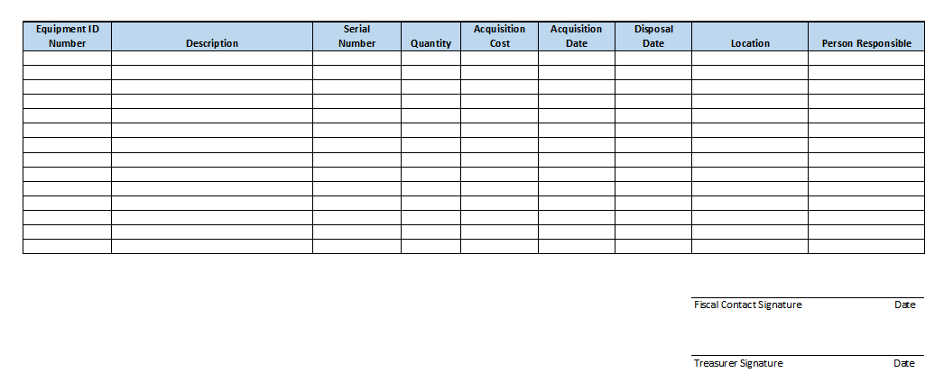
Annual Inventory Verification
Equipment Inventory List Guidelines:
Equipment ID number (e.g. tag #)
Description
Serial number (if applicable)
Quantity
Acquisition Cost
Acquisition Date
Disposal Date
Location
Person responsible

Slide 12
Property Disposition
University of Kentucky Owned Property:
All equipment or furnishings on the UK inventory and bearing a UK property decal must be returned to UK for disposal.
Contact the EBO for guidance on disposing of UK owned property.

Slide 13
Property Disposition
County Owned Property:
If an Extension District has been formed, the County Extension District Board has the authority to dispose of property acquired by the board under advisement by the local County Attorney.
Other county-owned property can be disposed of with approval of the appropriating body that acquired the property.
It is recommended that disposals be documented in the minutes of the meeting where the disposal is approved.
Keep all documentation that pertains to the disposal of any property.

Slide 14
Property Disposition
Federal Excess Property:
Must be returned to the Federal Surplus Property Office at UK for disposal.
Contact the EBO for guidance on disposing of FEP owned property.
Note: Any lost or stolen equipment must be reported to the appropriate authorities and documented before removal from any inventory list. Stolen equipment should be reported to local law enforcement as appropriate and lost equipment should be reported to the district board.

Slide 15
Questions

